Slide 1

Mediator-based POC RA test based on agglutination for ACPA detection on cards
Novio Catalpa’s Rheumatoid Arthritis Screening Assay
Fast, Affordable, Accessible
March, 2026
Notes:
Today, I would like to introduce an innovation that can transform RA diagnostics—Novio Catalpa’s RA screening assay.

Slide 2
Aim
Develop a rapid and cost-effective detection method for anti-citrullinated protein antibodies in rheumatoid arthritis patients
Anti-citrullinated protein antibodies (ACPA) are the most specific
and predictive serological biomarker in rheumatoid arthritis

Slide 3
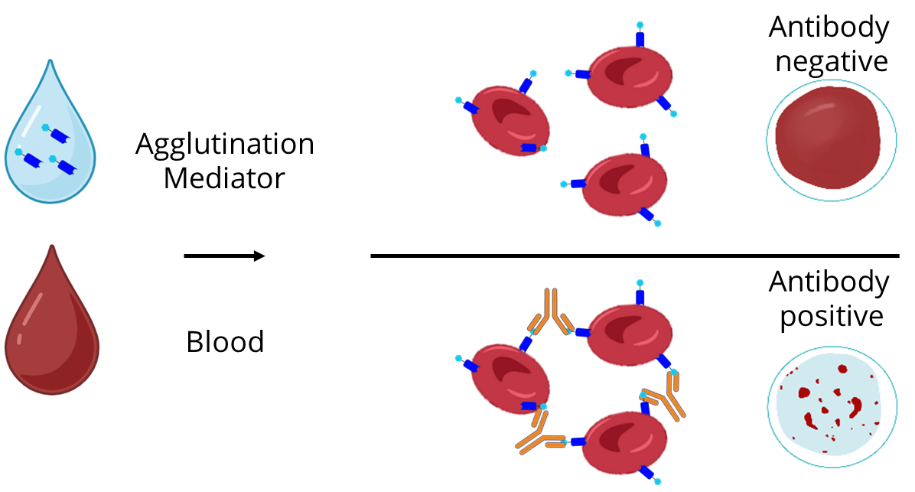
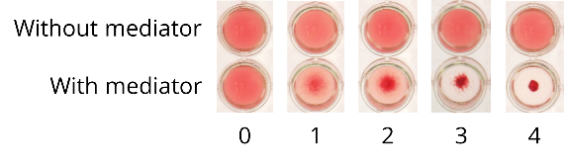




Antibody biomarker detection by red blood cell agglutination
Microtiter plates
Cards

Slide 4
Diagnostic performance of first generation ACPA mediator (scFv mediator)
ELISA | # |  | Anti-CCP2 positive
RA Cohort 1 | 103 |  | 67%
PsA Cohort 1 | 77 |  | 4%
RA Cohort 2 | 101 |  | 63%
Agglutination | # |  | Score 2+3+4
RA Cohort 1 | 103 |  | 61%
PsA Cohort 1 | 77 |  | 21%
RA Cohort 2 | 101 |  | 60%
RA: Rheumatoid arthritis
PsA: Psoriatic arthritis
Kruis et al. Rheumatol Adv Pract. 2025, 9:rkaf010

Slide 5
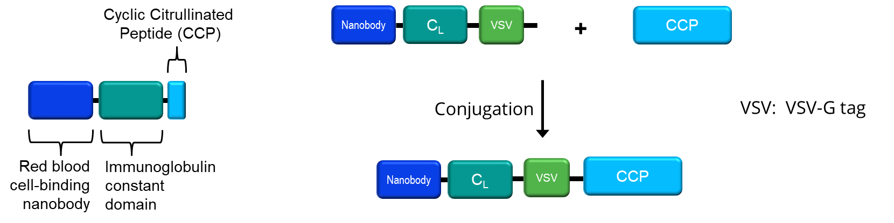
2nd generation (nanobody-based) ACPA agglutination mediator
Nanobody vs single-chain F_{V} (scFv): Lacks tendency for dimerization
Production easier, faster and cheaper
Higher stability
Higher sensitivity

Slide 6
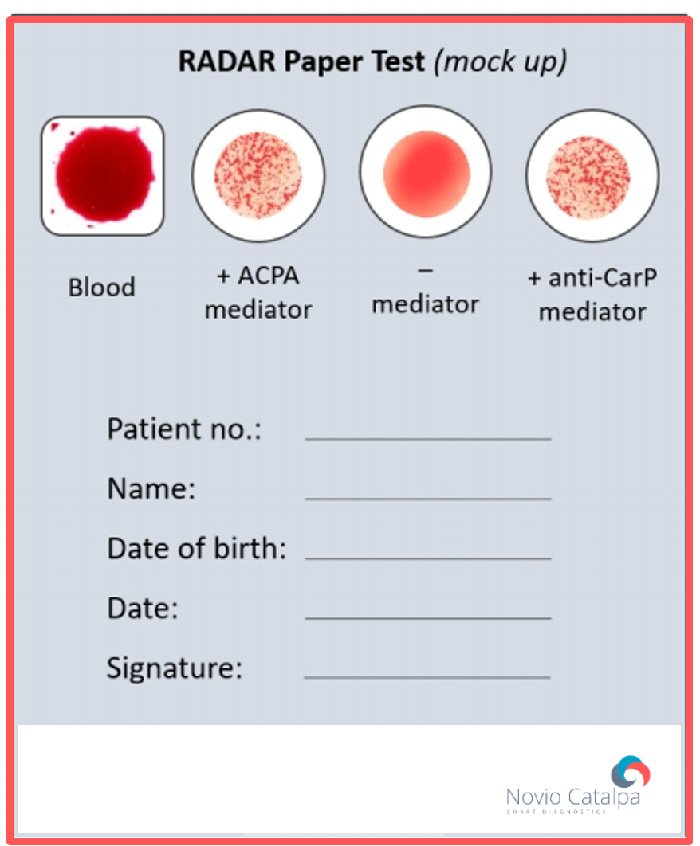
ACPA-dependent agglutination on cards (nanobody-based mediator)

Slide 7
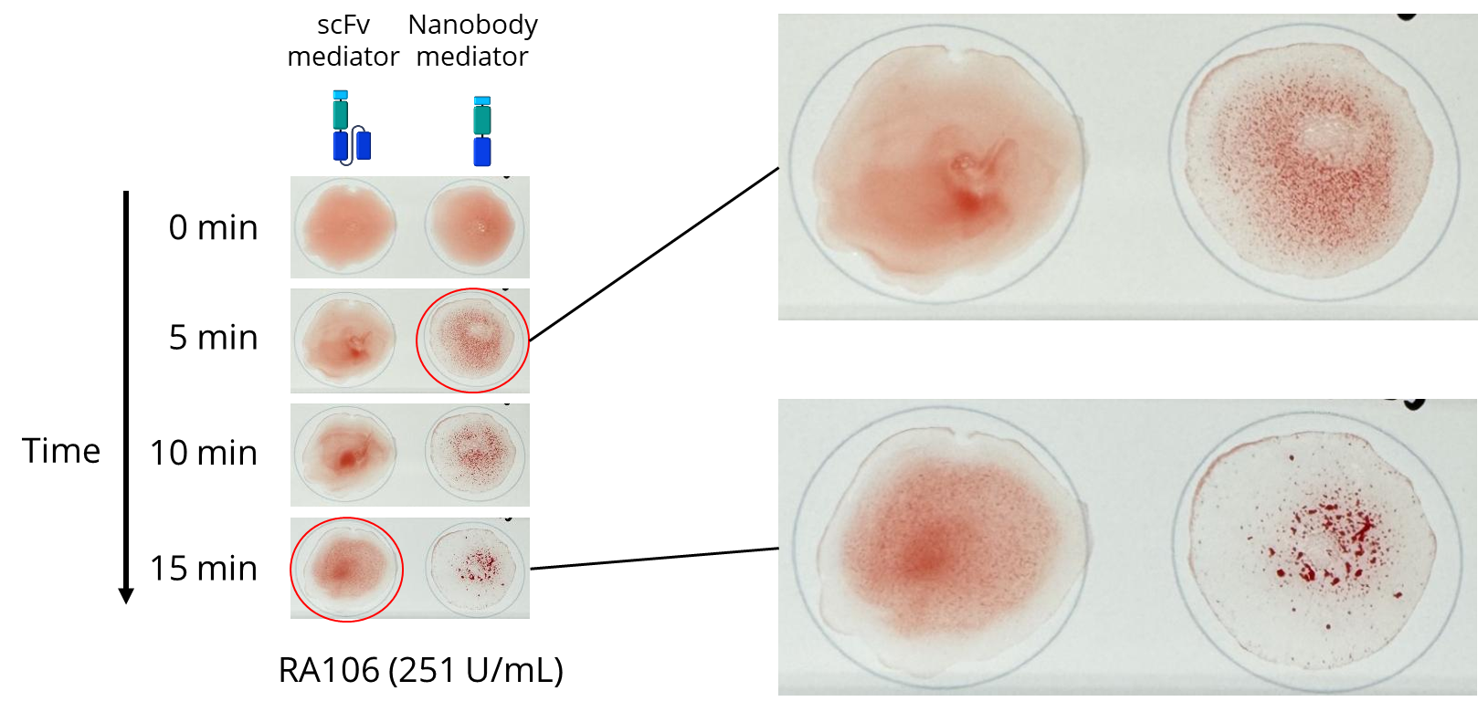
Nanobody-based mediator works faster than single-chain mediator

Slide 8
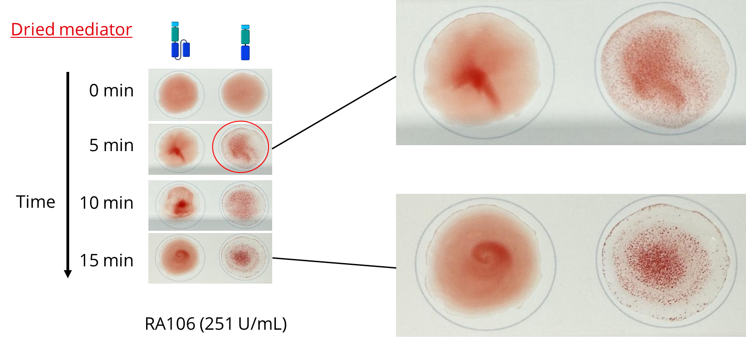
Nanobody-based mediator is functional after drying on cards
Dried mediator

Slide 9
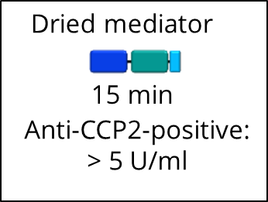
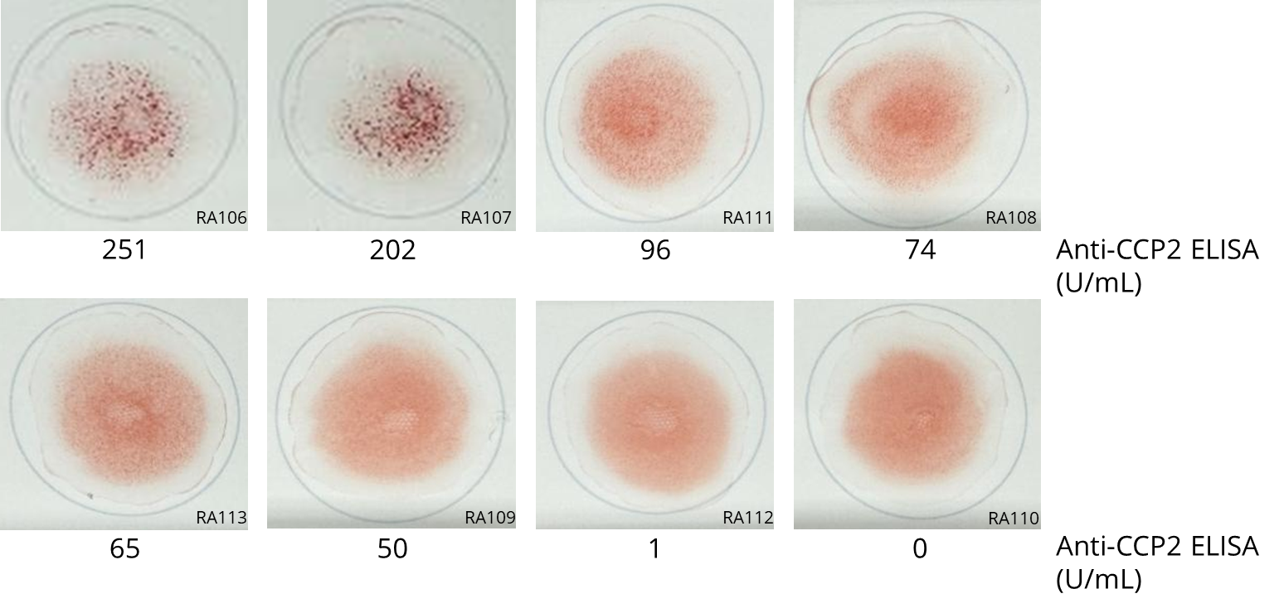
Nanobody-based agglutination allows low-titered anti-CCP2 detection

Slide 10
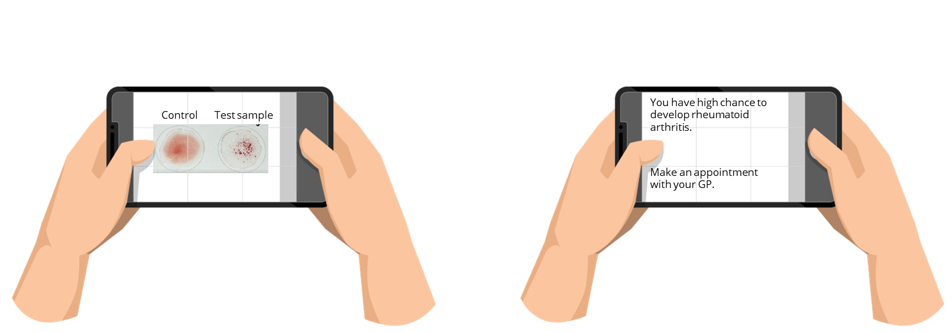
AI image analysis in development

Slide 11
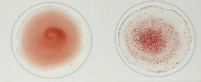


Conclusions
ACPA detection by hemagglutination is simple, fast, has visual readout
and does not require sophisticated equipment.
The sensitivity of the ACPA-dependent hemagglutination is similar to
that of the golden standard CCP2 ELISA.
The nanobody-based mediator has several advantages compared to the
single-chain Fv-based mediator:
Lacks tendency for dimerization
Easier, faster and cheaper production
Higher stability

